Slide 1

Using Dynamic Rupture Simulations to Improve Ground Motion Hazard Models for Normal Faults
Yair Franco, Daniel Trugman
SSA 2026

Slide 2
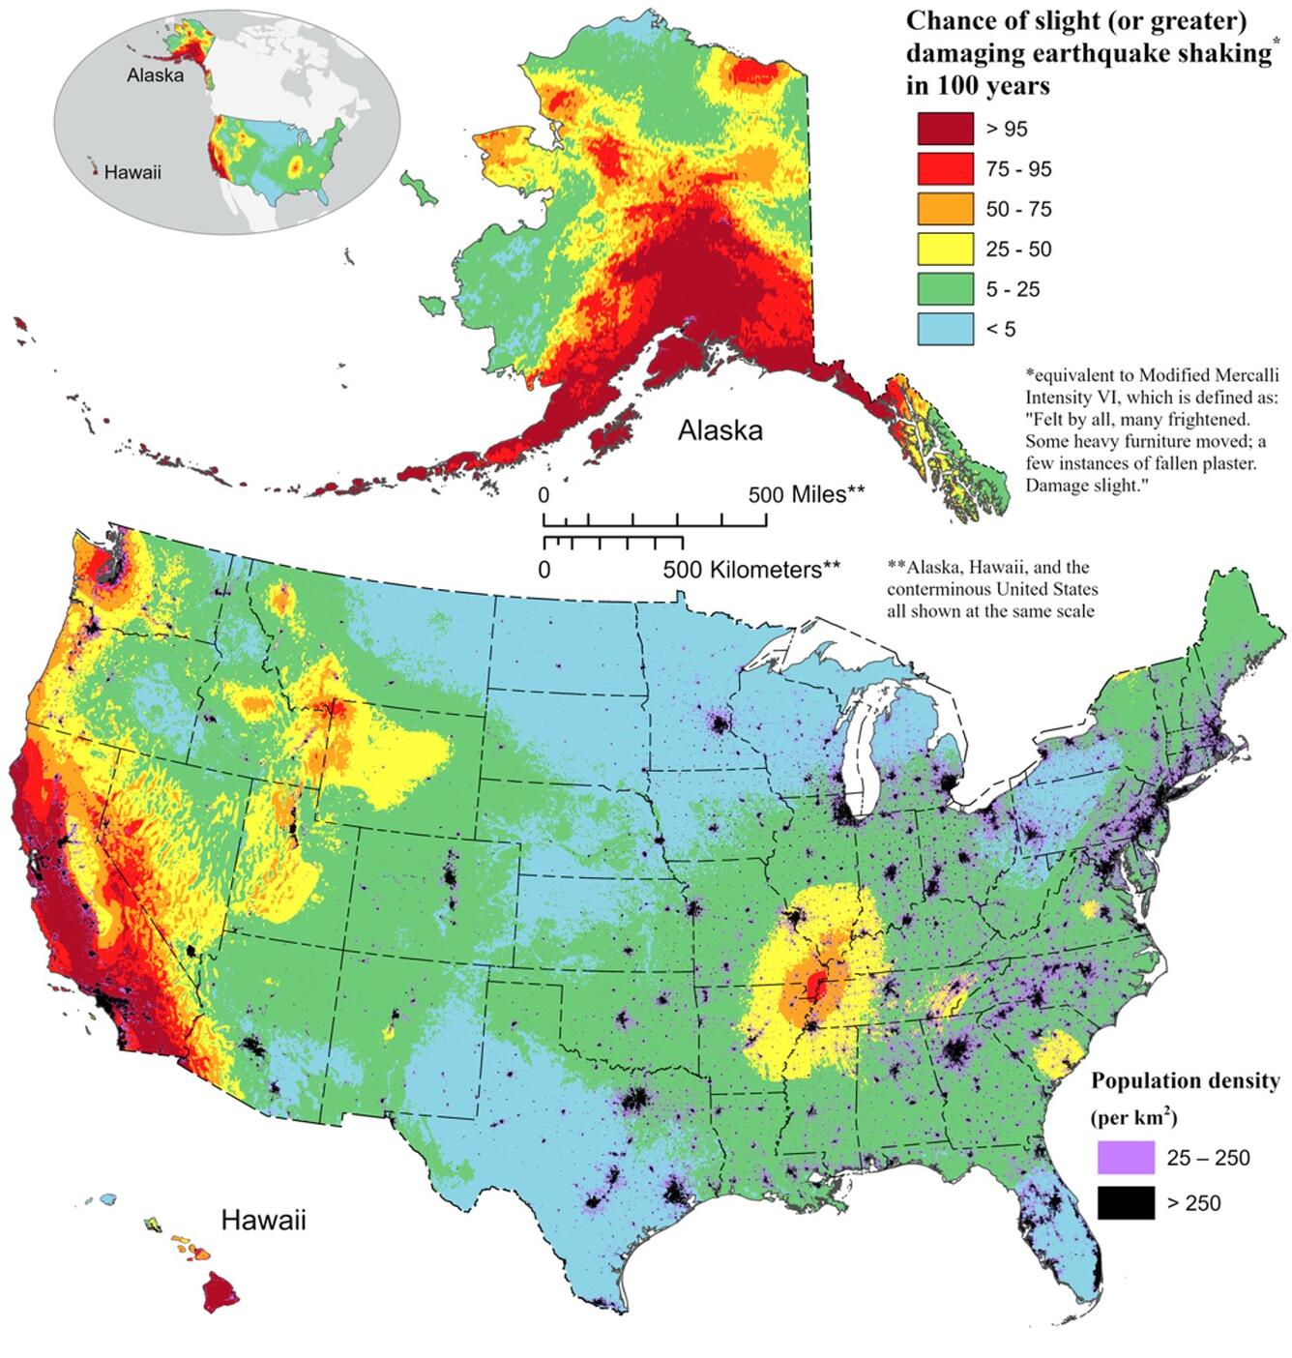
Motivation
Hazard assessments are basis for earthquake preparation
Developed in part with ground motion models (GMMs)
GMMs depend largely on empirical ground motion records
[Petersen et al., 2023]

Slide 3
Motivation
Ground motion data for large normal-faulting earthquakes is relatively scarce
  Particularly near-fault records
Could this be affecting hazard estimates in normal-faulting environments?

Slide 4
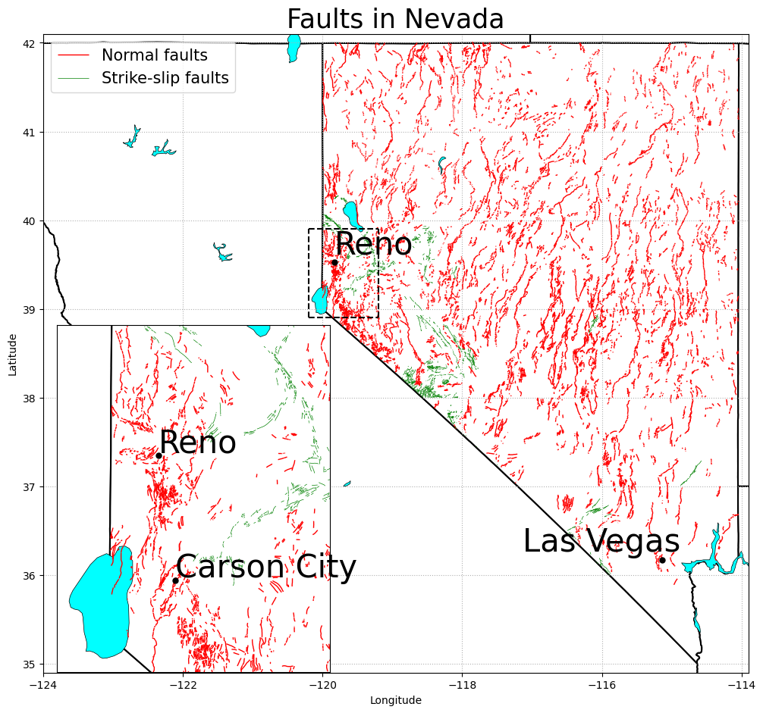
Motivation
Normal fault hazard may not be as well constrained as for other mechanisms
Implications for areas where normal faulting is more common

Slide 5
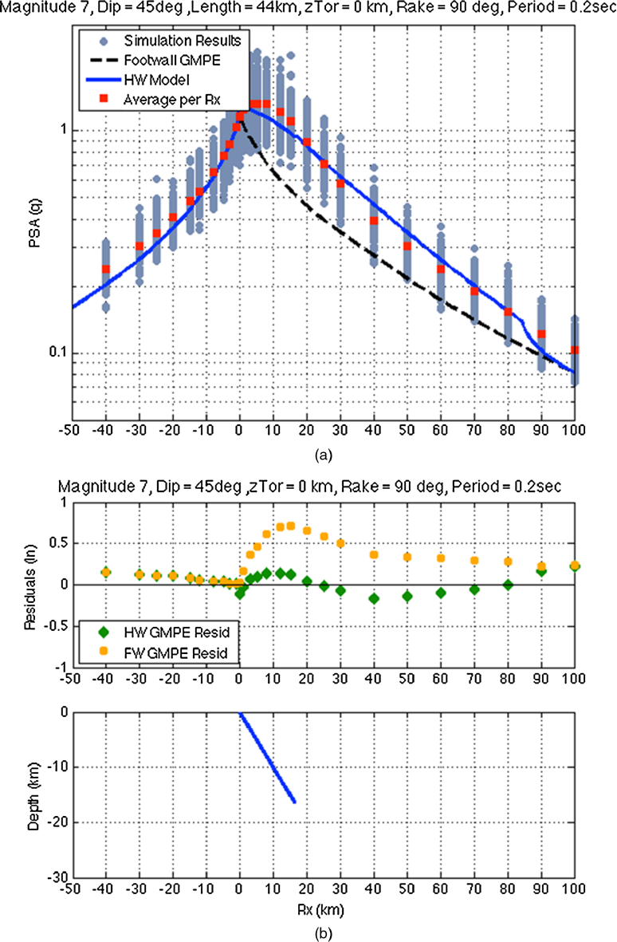
Motivation
(Hanging wall term regression for dip-slip)
Dynamic simulations: see physical effects on ground motion
Simulation data has been used for developing GMMs
  Kinematic – neglect some important dynamic effects
  Assumptions made on dip-slip mechanisms
(All simulations here are reverse-slip)
(Donahue & Abrahamson, 2014)
Notes:
-hanging wall effects
-normal vs reverse dynamics

Slide 6
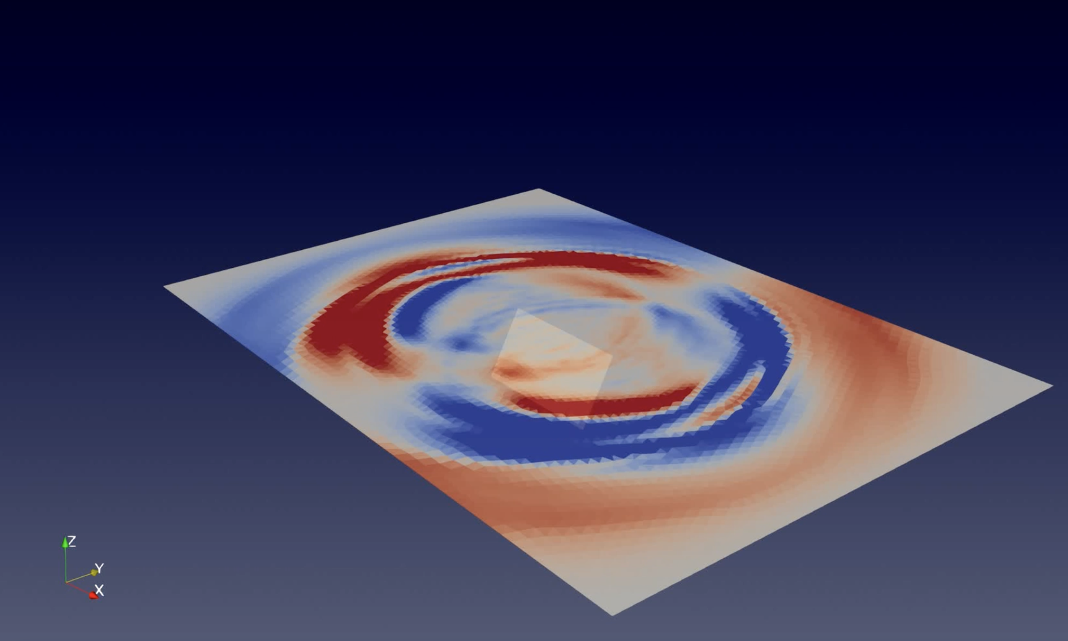
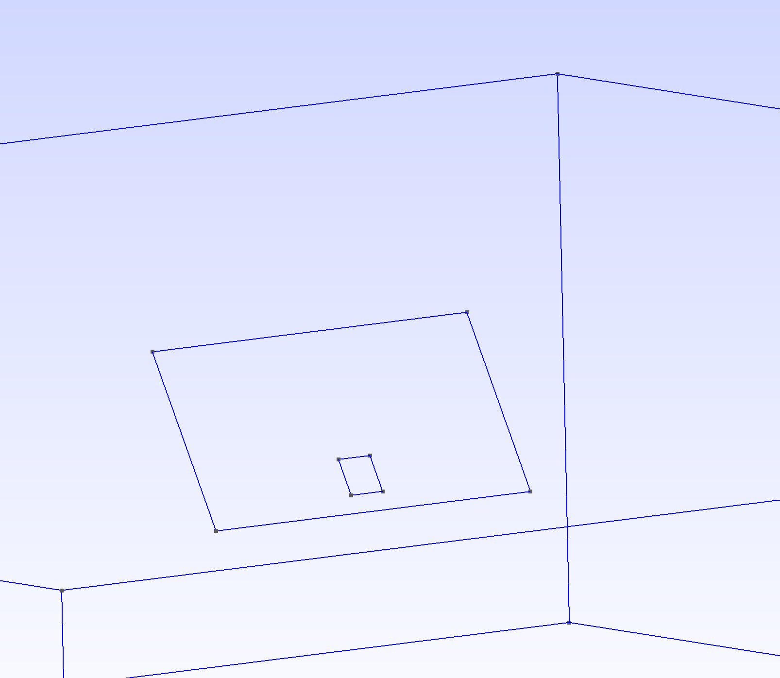
Method
SeisSol: 3D dynamic rupture simulations
Scenarios adapted from SCEC TPV10 model
  Normal fault dipping 60°
Velocity data from simulation converted to RotD50
(Homogenous domain)
30 x 15 km fault
3x3 km nucleation patch

Slide 7
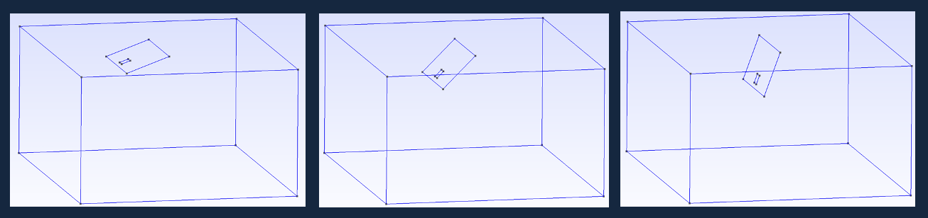
Method
Scenarios tested:
  Changing fault dip (25°-75°)
  Reverse-slip mechanism
  Moving nucleation patch
  Adding a 1D velocity model

Slide 8
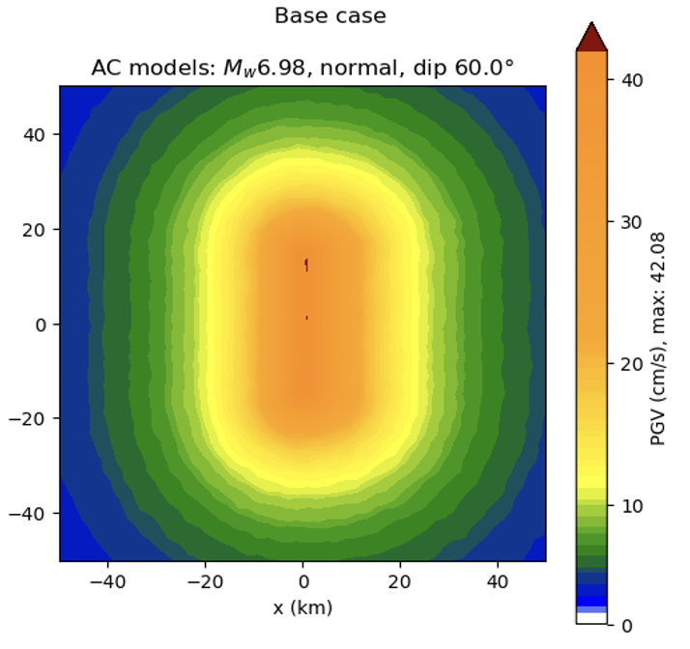
Method
GMM comparison:
  Data obtained via OpenQuake
  Active Crustal models
    Used in 2023 National Seismic Hazard Model
  Ratio of average of models vs. SeisSol PGVs used for comparison

Slide 9
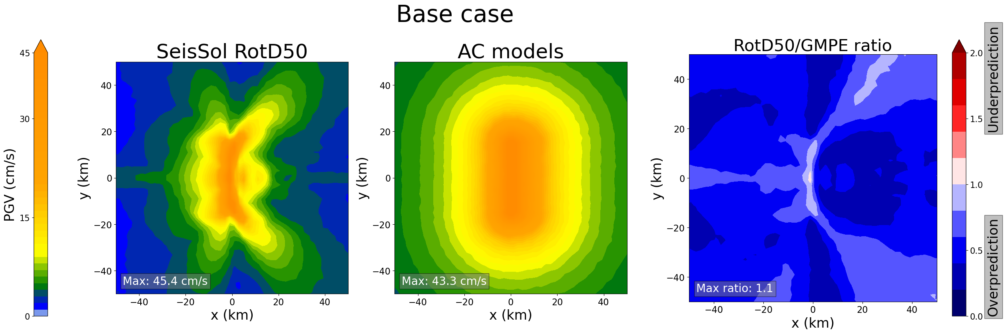
Results — base case
Trend towards underprediction except at surface trace
Radiating areas of higher PGV

Slide 10
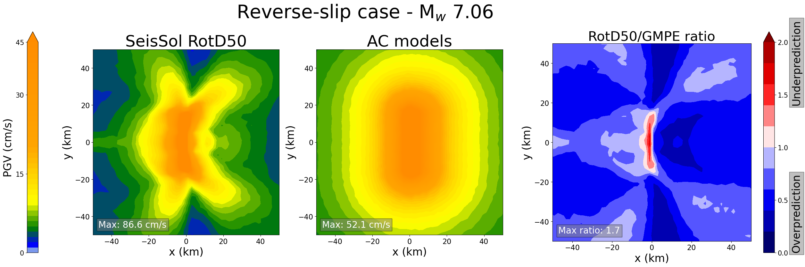
Results — reverse-slip case
Stronger ground motions than normal-slip (expected)
Greater underpredictions near the surface trace
Similar trend towards overprediction elsewhere

Slide 11
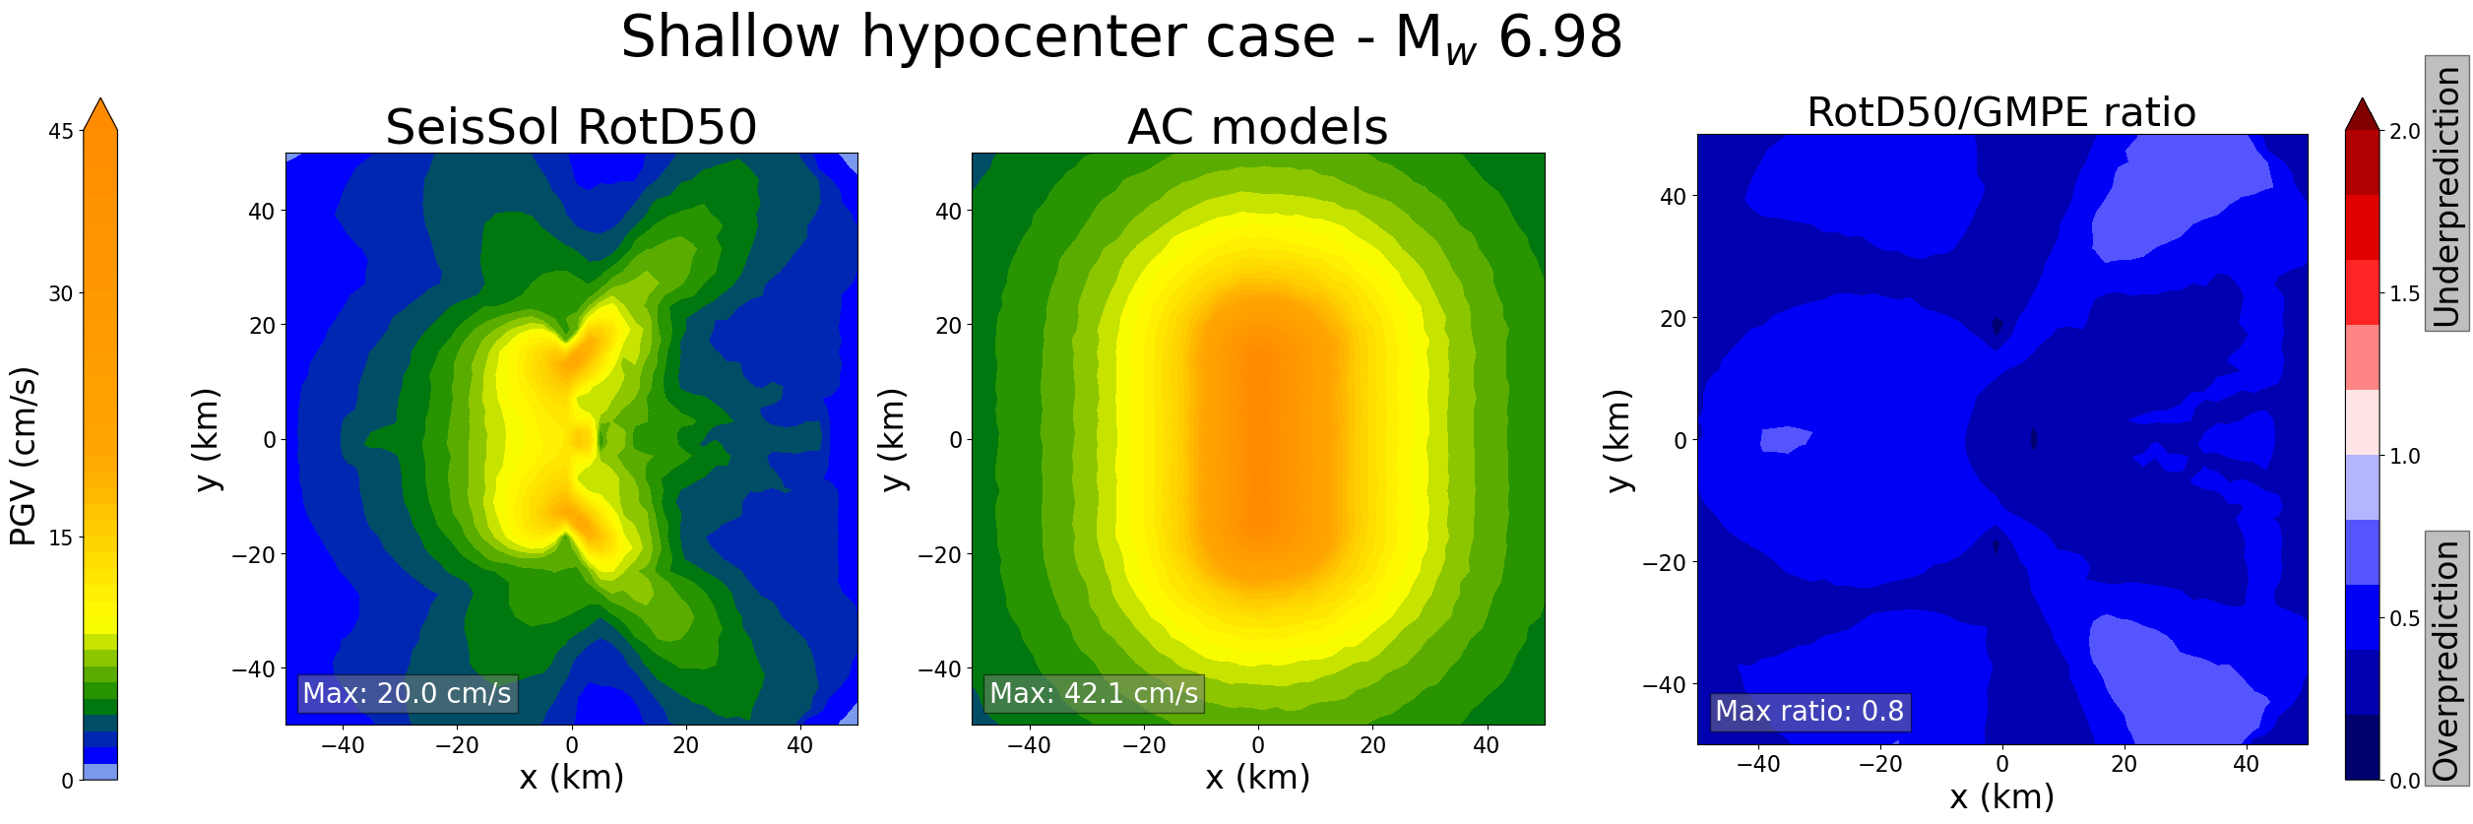
Results — shallower hypocenter
Max PGVs lower than base case
Underprediction more prevalent

Slide 12
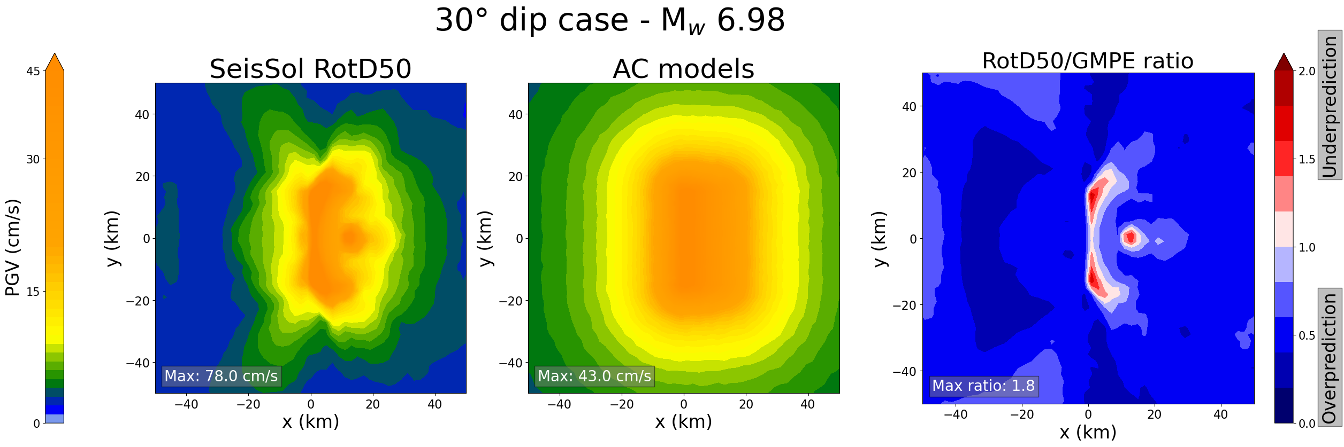
Results — changing dip
Stronger localized discrepancies in shallow dip (30°)
Notes:
Hypocenter here would be x = 15 km*cos(30) = 13km so the blob is not at the hypocenter but a little further downdip from it

Slide 13
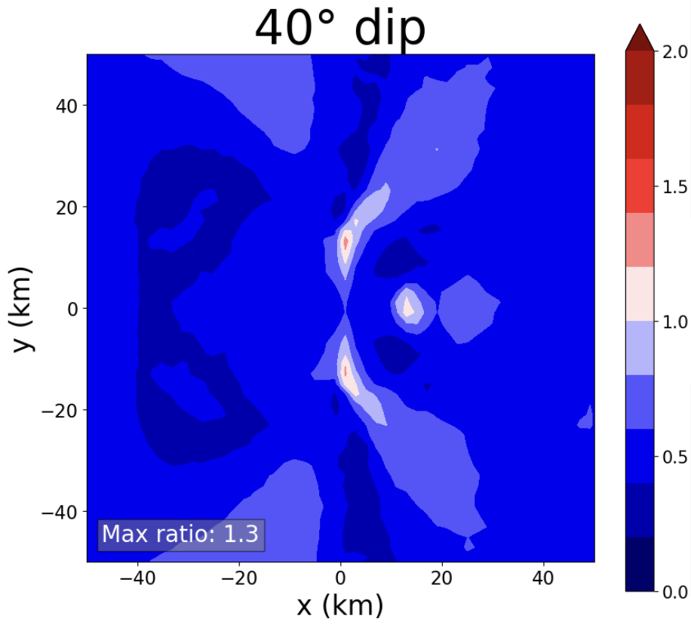
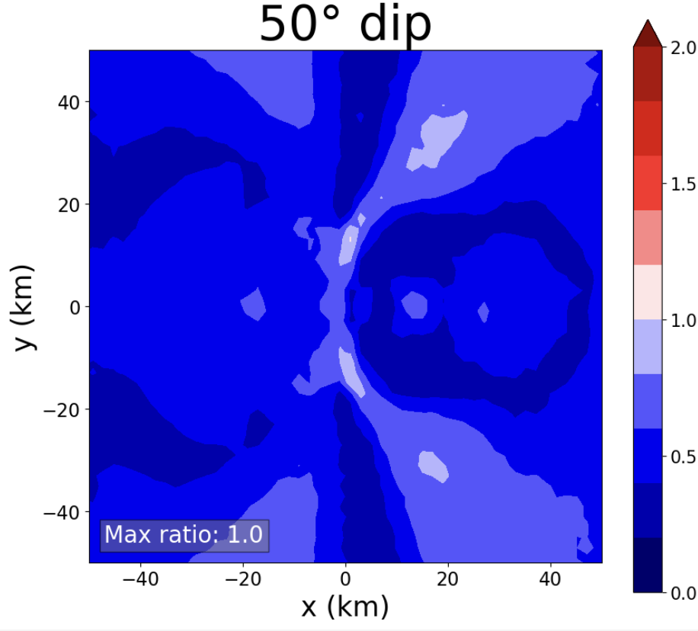
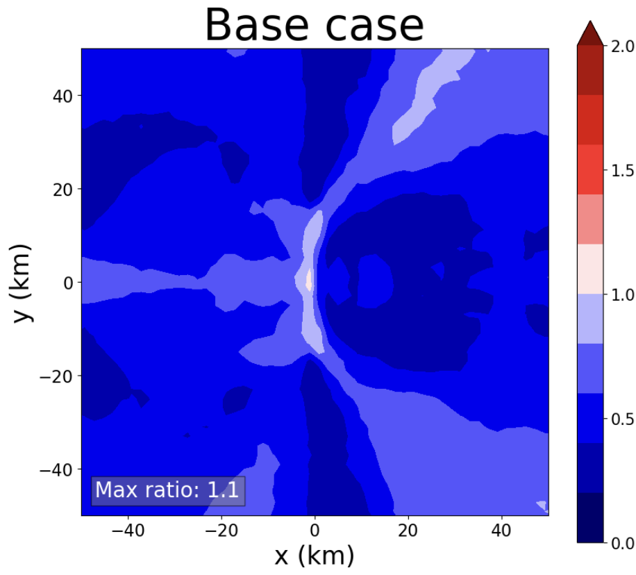
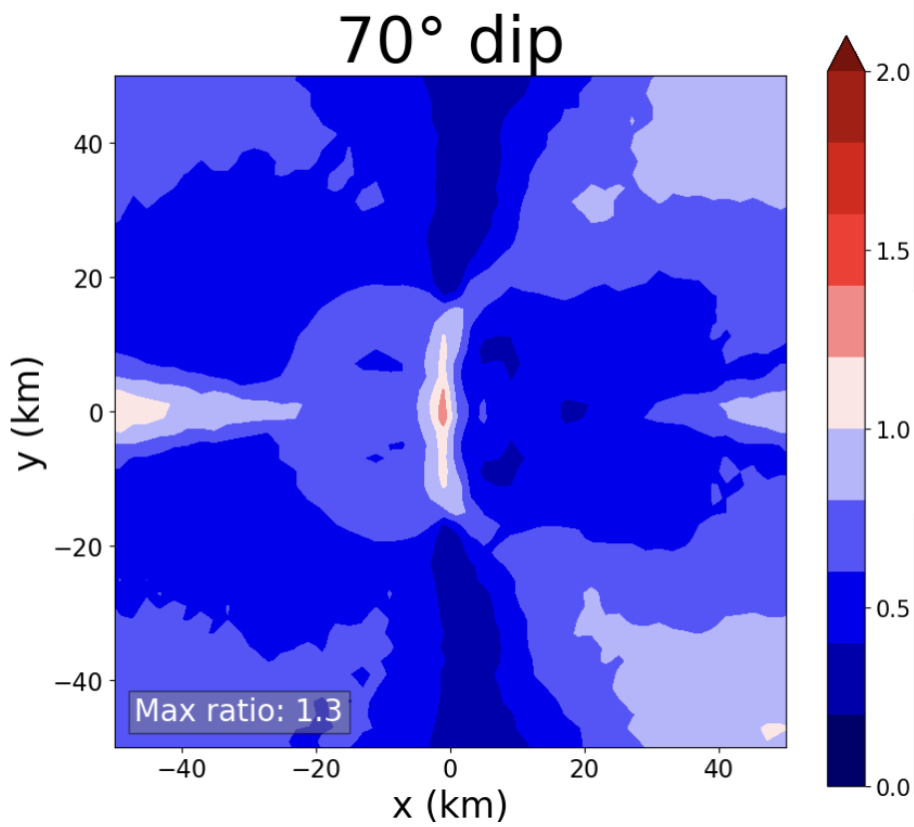
Results — changing dip
Pattern changes with dip
Constructive interference at y = 0 (centered along strike) more apparent at steeper dips
Normal faults are more commonly in the 50-70° range

Slide 14
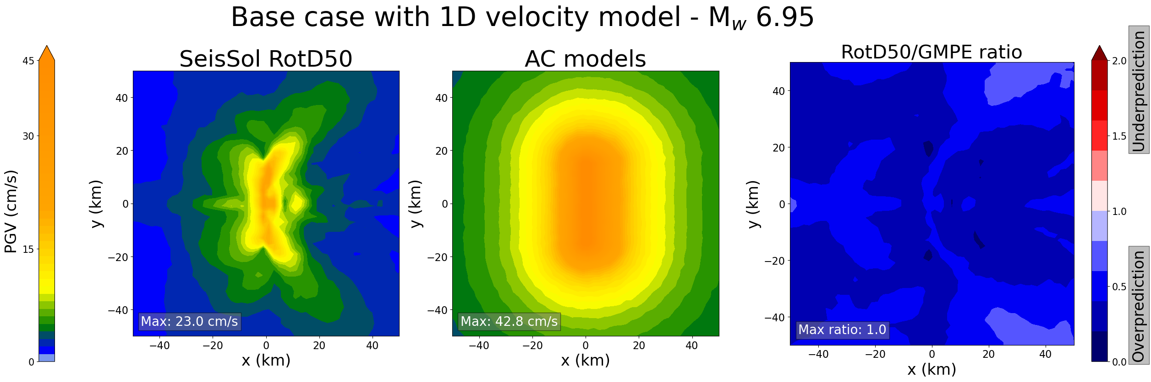
Results — 1D velocity model
V_{p} = 5 km/s, V_{s} = 2.9 km/s in the top 5 km
Overprediction throughout entire area

Slide 15
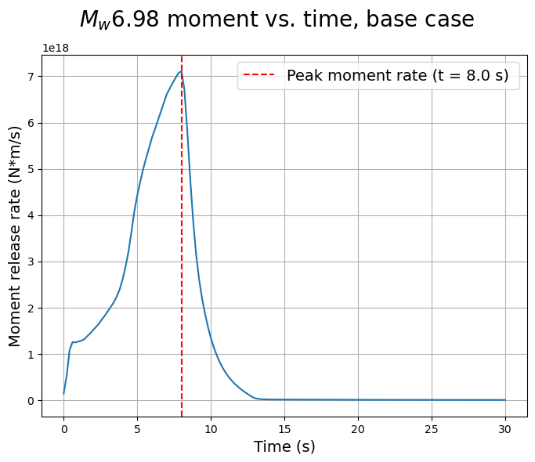
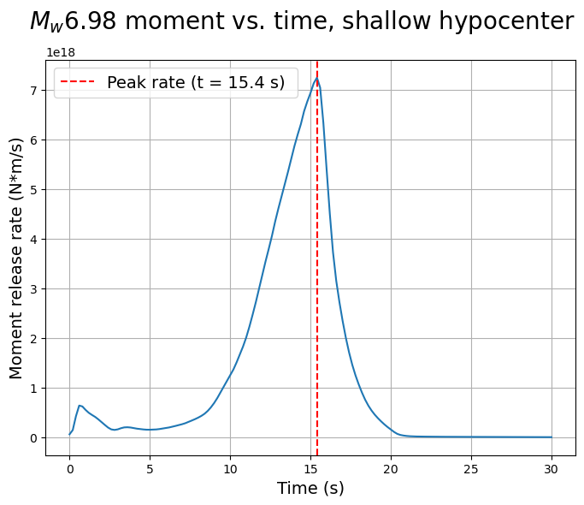
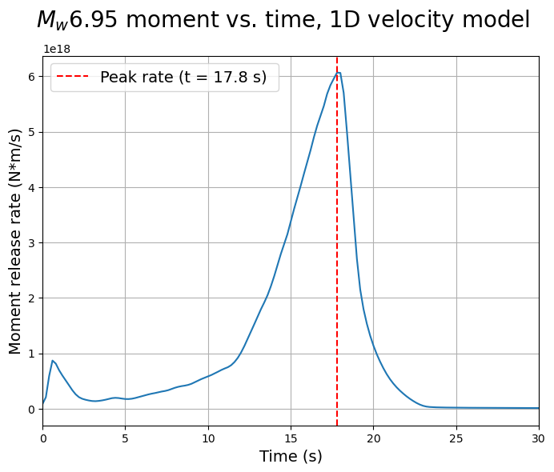
Results — physical effects
Multi-stage rupture effect in some scenarios
Possibly caused by differences in stress

Slide 16
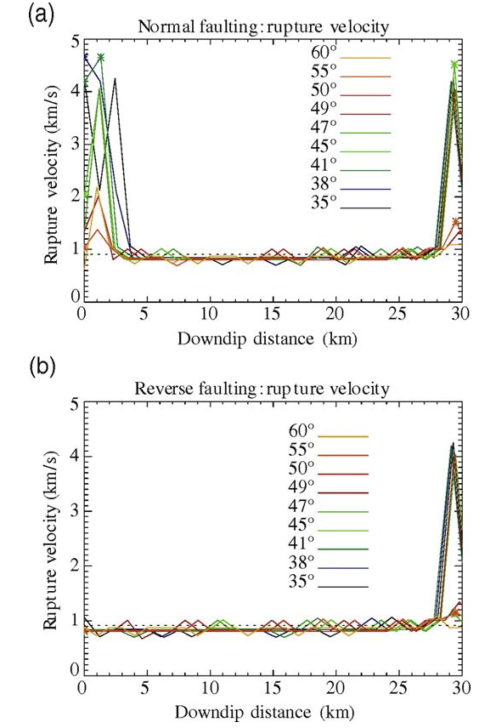
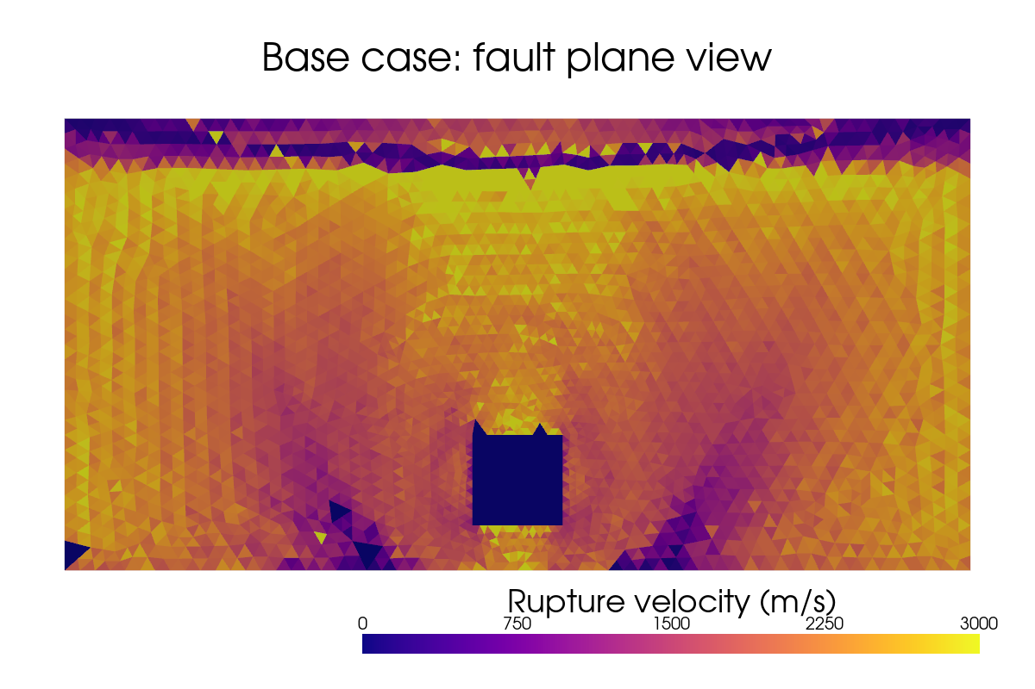
Results — physical effects
(O’Connell et al., 2007)
Near-surface ”unclamping effect” unique to normal-slip

Slide 17
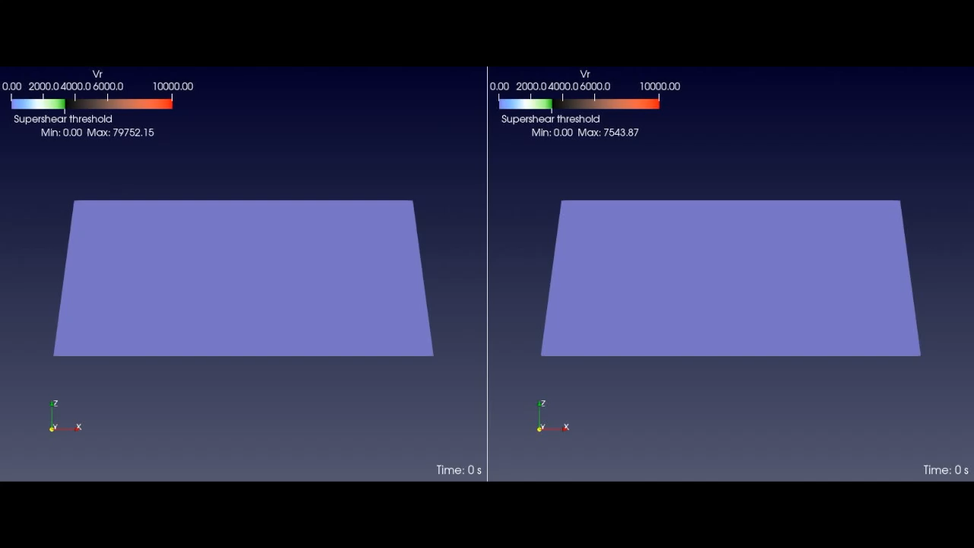
Results — physical effects
(Base case)
(1D velocity model)

Slide 18



Conclusions
GM prediction models
Rupture simulations show dynamic effects that affect ground motion
  Rupture speeds and breaks in propagation
Variability beyond GMM uncertainties in a lot of cases
Hazard estimates would benefit from richer dataset including dynamic rupture simulation results
GM records
Simulations
Hazard estimates

